Slide 1
OLED Display
Pin | Description | Attached to
Gnd | Ground | ground
Vin | power | 5V
CS | Chip select | D3 (Digital)
RST | reset | D4
D/C | Not sure | D5
CLK | Not sure | D6
Data | Data | D7

Slide 2
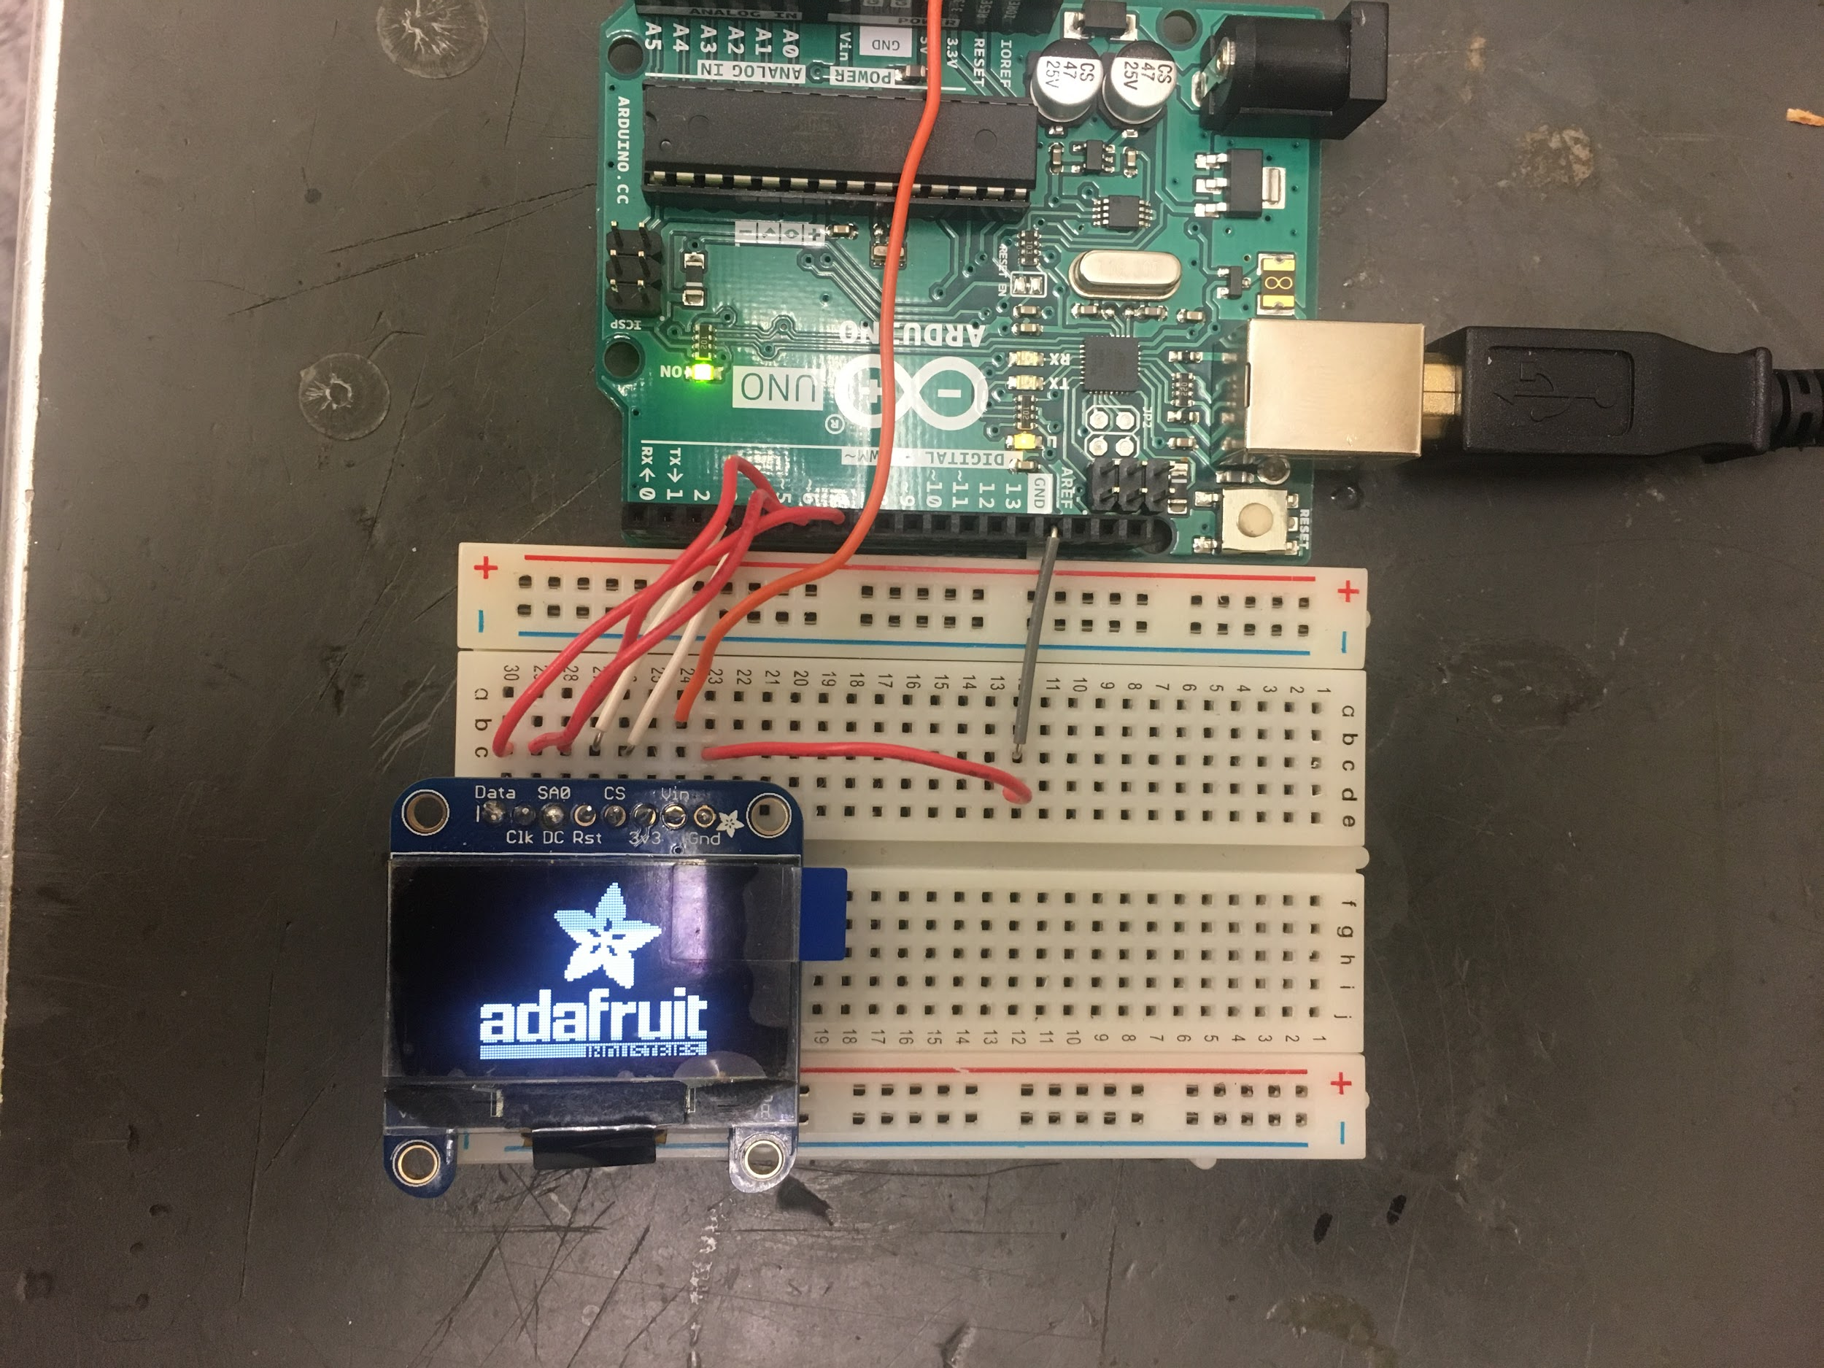
Basic display of OLED Display (function) Display.

Slide 3
Good to know:
The OLED Display is an input material, menaing it takes it’s commands from the Arduino processor, so connecting it along the same pins with an output equipment such as various sensors causes issues.

Slide 4
OLED Display with an Accelerometer
Pin | Description | Attached to
GND | Ground | GND
VCC | Power input(3.3v) | 3.3V
CS | Chip Select | D10
INT 1 | Interrupt 1 output | N/A
INT 2 | Interrupt 2 Output | N/A
SDO | Serial Data Output (SCO) | D12
SDA | Serial Data (SDA) | D11
SCL | Serial Communications Clock (SCL) | D13

Slide 5
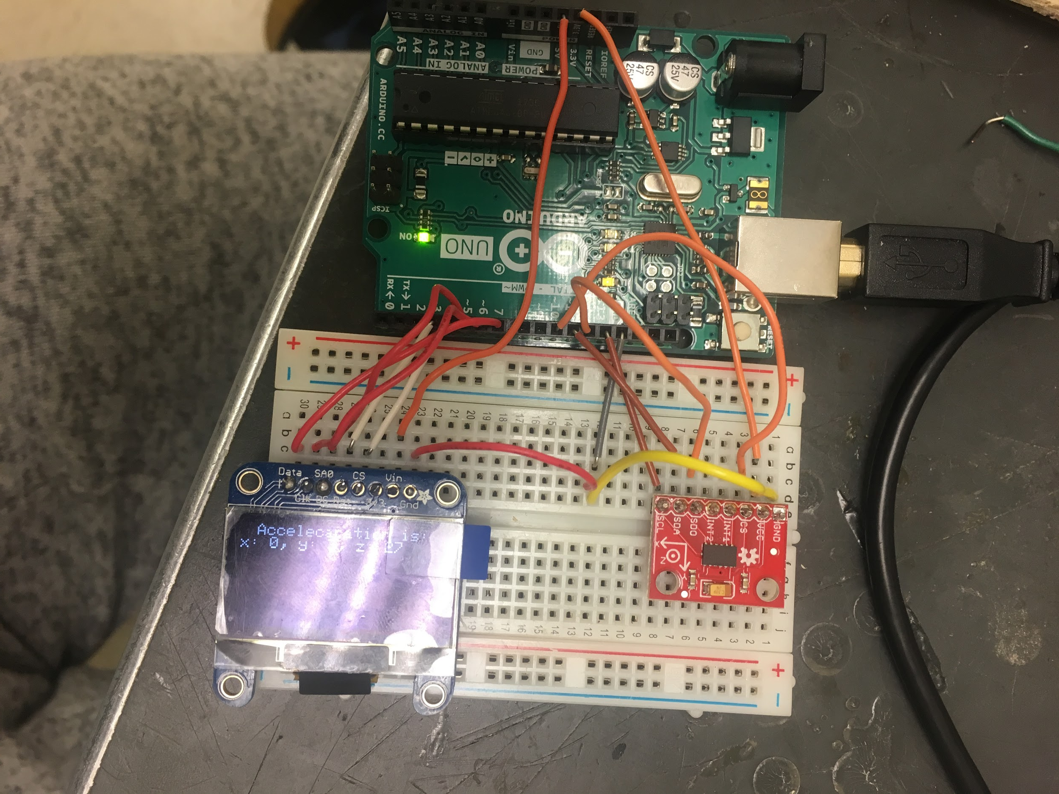
OLED Display with accelerometer

Slide 6
OLED Display with Analogl temp sensor
Pin | Description | Attached to
1 | Ground | GND Pin
2 | Analog Output | Pin A2
3 | Ground | GND pin
*With the flat side facing you:

Slide 7
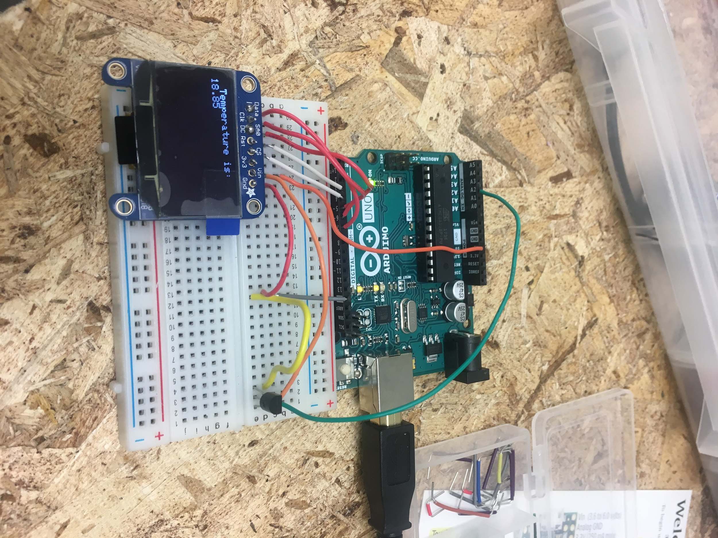
OLED Display with aa temp sensor picture:

Slide 8
OLED Display with analog pressure sensor
Pin | Description | Attached to
1 | nothing | Not connected
2 | 5V (Power) | 5V pin
3 | Analog output | Pin A0
4 | Ground | GND pin

Slide 9
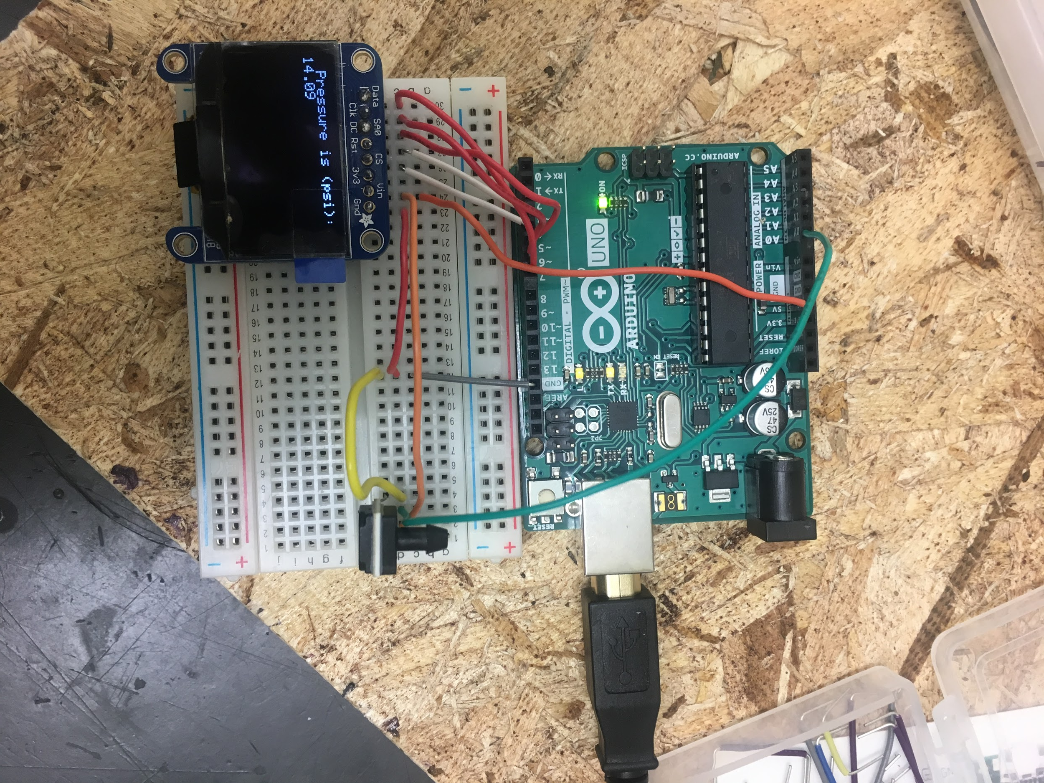
OLED Display with a pressure sensor

